Slide 1
CMPE 275 Grand challenge 2
Team Achievers
Sushmitha Dhummi Thrilochana - 016043755
Sai Sri Harshini Kosuri - 016005912
Thirumala Sai Krishna Kaaja - 016033758
Santhosh Bodla - 016002454
Abhiram Yenugadhati - 015962128
Sai Subhash Reddy Gangireddygari - 016003403

Slide 2
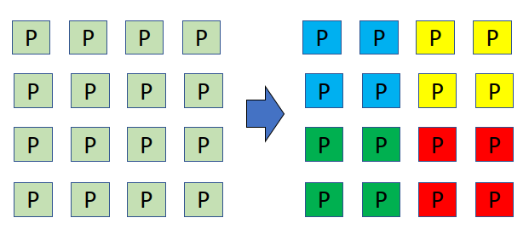
Problem Statement
To create partitioned compute space - Blue, Yellow, Green, Red that works independently.
Share or exchange information along shared edges.

Slide 3
Fundamentals of Parallel Processing
Generally broken down into 4 major steps-
Decomposition: This involves breaking down large computation into smaller tasks.
Assignment: This step involves assigning of the tasks to processes. How do you assign?
This might involve distribution of the tasks in even or un-even fashion.

Slide 4
Orchestration: Now that we have our data mapped to processes, how are the processes talking with each other? Answer is Orchestration.
Processes talk to each other and share any information that needs to be shared among processes.(Processes running on Multi-core chips across multiple nodes)
Mapping: In this stage, we are mapping our parallel program process to physical hardware.
Mapping must be done in such a way distance for communication among processes must be minimal.

Slide 5
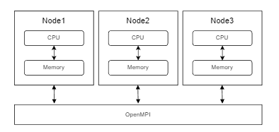

Open MPI (Message Passing Interface)
A High Performance Message Passing Library
Useful for parallel computing in distributed memory model.
Here, message passing is used to synchronize distribution of computation and collect results between nodes .
Core Components
Communicators – Set of processes allowed to communicate among themselves.
Ranks – Each process is assigned a unique rank.
Messages are pre-defined datatypes
ex: MPI_INT, MPI_FLOAT, MPI_CHAR
Point-to-point communication (Blocking/ Non-Blocking)
ex: MPI_Send(), MPI_Recv()
Collective communication
ex: MPI_Bcast(), MPI_Scatter(), MPI_Gather()
Notes:
Since for the challenge we need to use partitioned compute space, we decided to use OpenMPI, because it mainly caters for distributed memory architecture,
Because unlike in open mp where we are dealing with shared memory, when are working in a partitioned compute space, we will have to work with a collection of independent cores or nodes which are having a memory of its own and does not require locks like in shared memory used by OpenMP.
However, sychronization is required to distribute computation and collect results between nodes, that is done through message passing.
Communicators – group of processes .
Default: MPI_COMM_WORLD
Ranks – Each process is assigned a unique rank
Messages are pre-defined datatypes
ex: MPI_INT, MPI_FLOAT, MPI_CHAR
Point-to-point communication
A process sends an individual message to/from another process. (Blocking/ Non Blocking)
ex: MPI_Send(), MPI_Recv()
Collective communication
A process sends (or chunks) a message to all other process
ex: MPI_Bcast(), MPI_Scatter(), MPI_Gather()

Slide 6
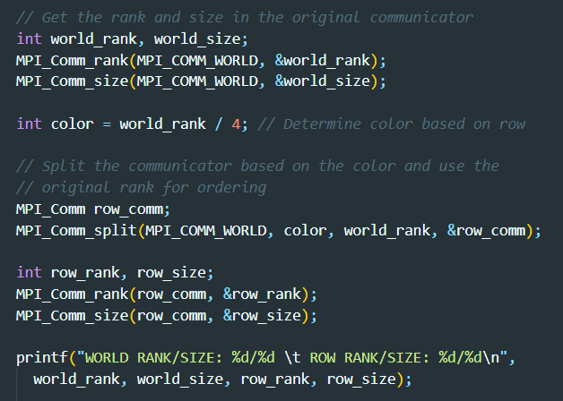
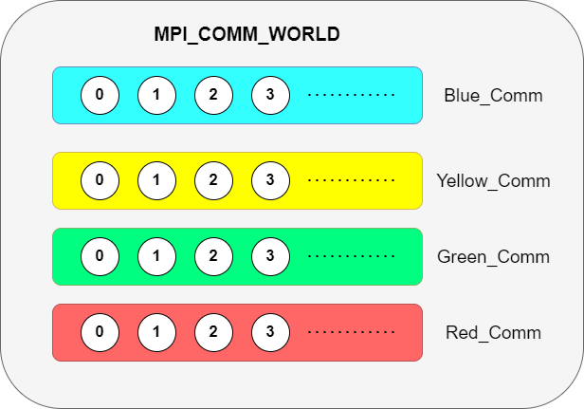
Approach
Notes:
1st parameter "comm" is the communicator we want to split. In our case it will be MPI_COMM_WORLD
2nd color parameter decides to which communicator the process will belong after the split.
3rd is the key which will be used to assign rank of the process in new comm
4th new communicator.

Slide 7
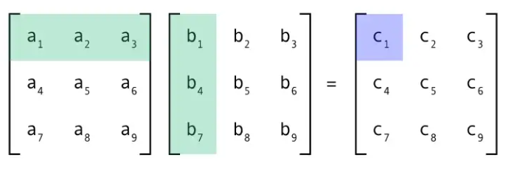
Matrix Multiplication
1. Here we are using the above discussed parallel programming concepts and dividing the rows and columns between different processes.
2. Each process will compute its work independently and return back the response through message passing

Slide 8
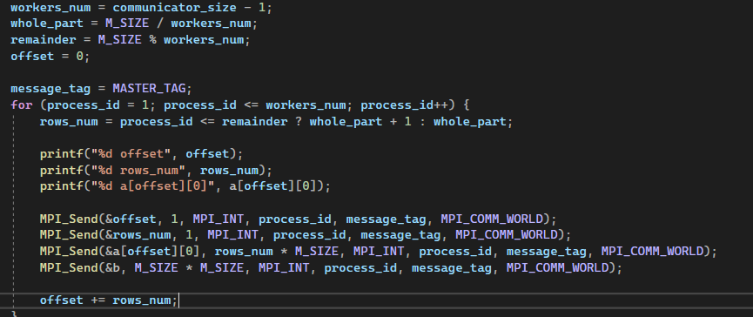

Slide 9
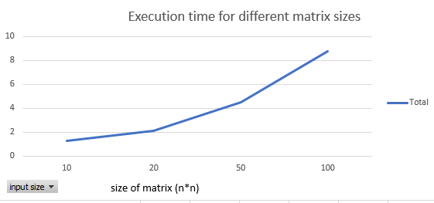
Results
Time in micro seconds
The above execution times were calculated with 4 processes and 1 communicator

Slide 10
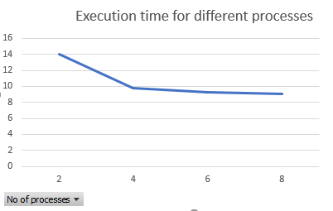
Results
Time in micro seconds
We considered 100*100 matrix size as input for the above analysis

Slide 11
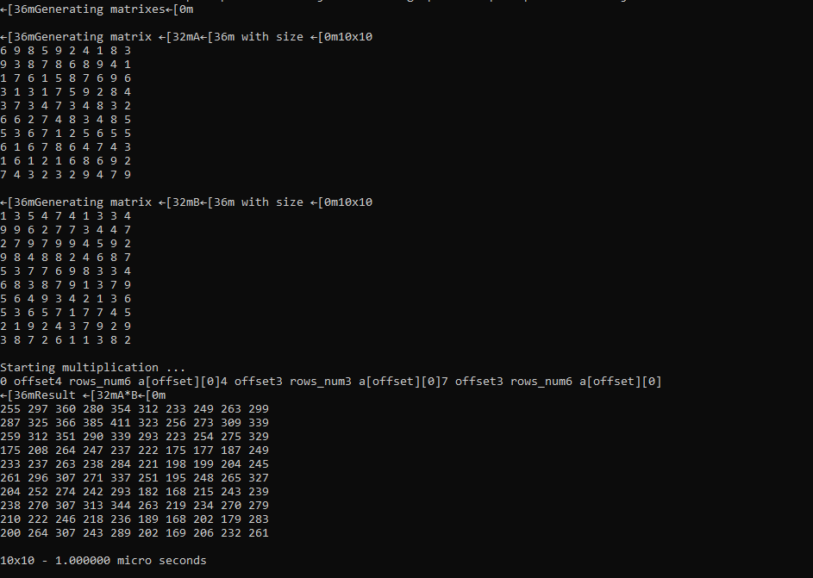
Output

Slide 12

References
https://www.open-mpi.org/doc/v4.0/man3/MPI_Send.3.php
https://www.codingame.com/playgrounds/349/introduction-to-mpi/measuring-time

Slide 13
THANK YOU

